Slide 1
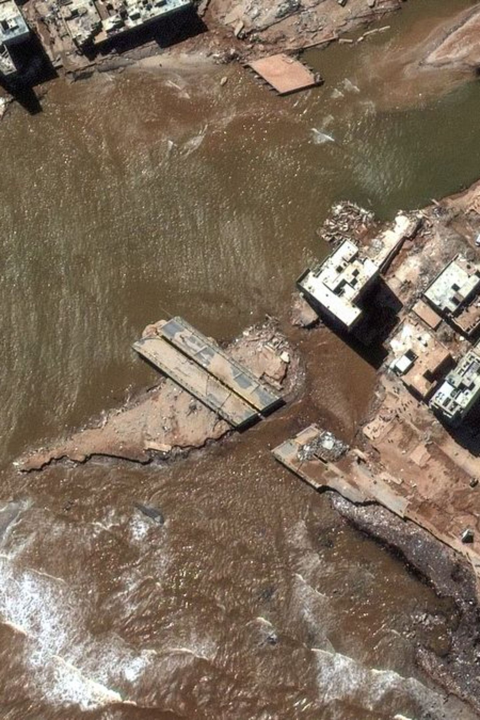
AI-Based Disaster Detection System
Presented By: Sanjanaa Sree P
Reg No. : 192311454
B.E. Computer Science and Engineering

Slide 2
What is Disaster Detection?
Disaster detection is the process of identifying and monitoring events that can cause significant damage to people, infrastructure, and the environment. Traditional monitoring systems often rely on manual observation, whereas AI-based systems can automatically analyze large volumes of data in real time.
🌊 Floods
🔥 Wildfires
🌍 Earthquakes
⛰Landslides
🌀 Cyclones
🏭 Industrial Accidents
AI helps authorities detect these disasters faster and make informed decisions during emergencies.

Slide 3

Challenges in Traditional Systems
Why AI is Needed
Processes large datasets quickly
Detects patterns that humans may miss
Provides real-time monitoring
Improves prediction accuracy
Supports faster decision-making
Current Limitations
Delayed warning generation
Human errors in monitoring
AI significantly enhances the efficiency and effectiveness of disaster management systems.
Limited data processing capability
Slow emergency response

Slide 4
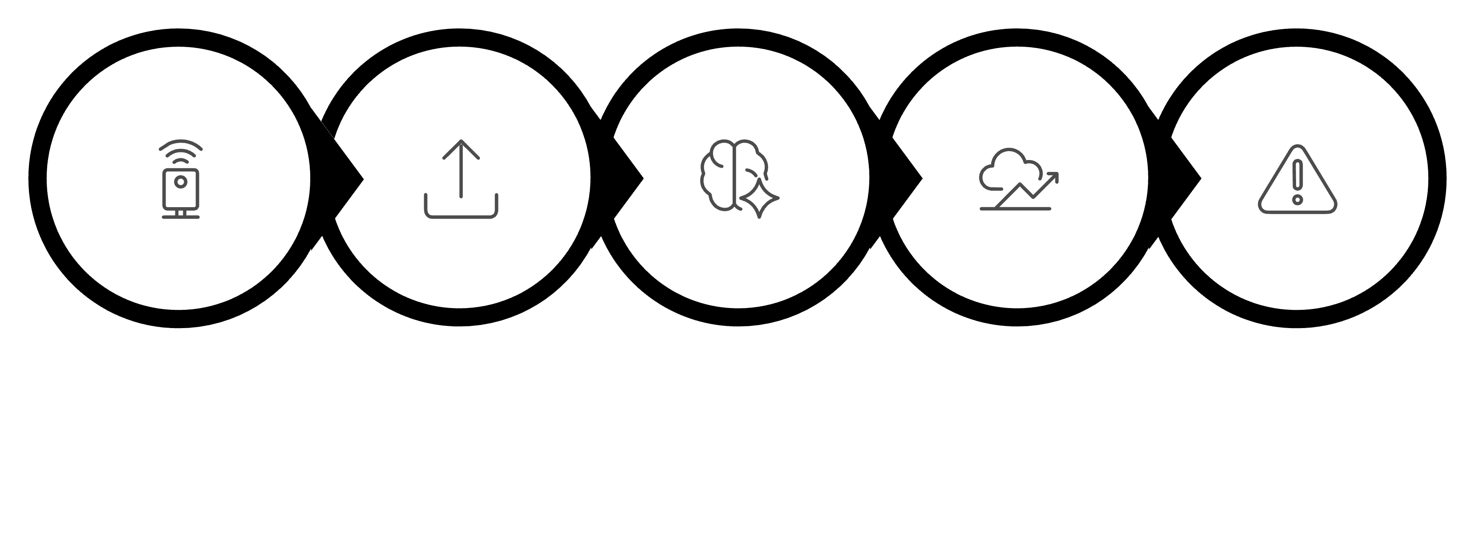
How the System Works
Data Transmission
Data Collection
AI Analysis
Prediction
Alerts
This automated workflow ensures rapid detection and response to disaster situations.

Slide 5
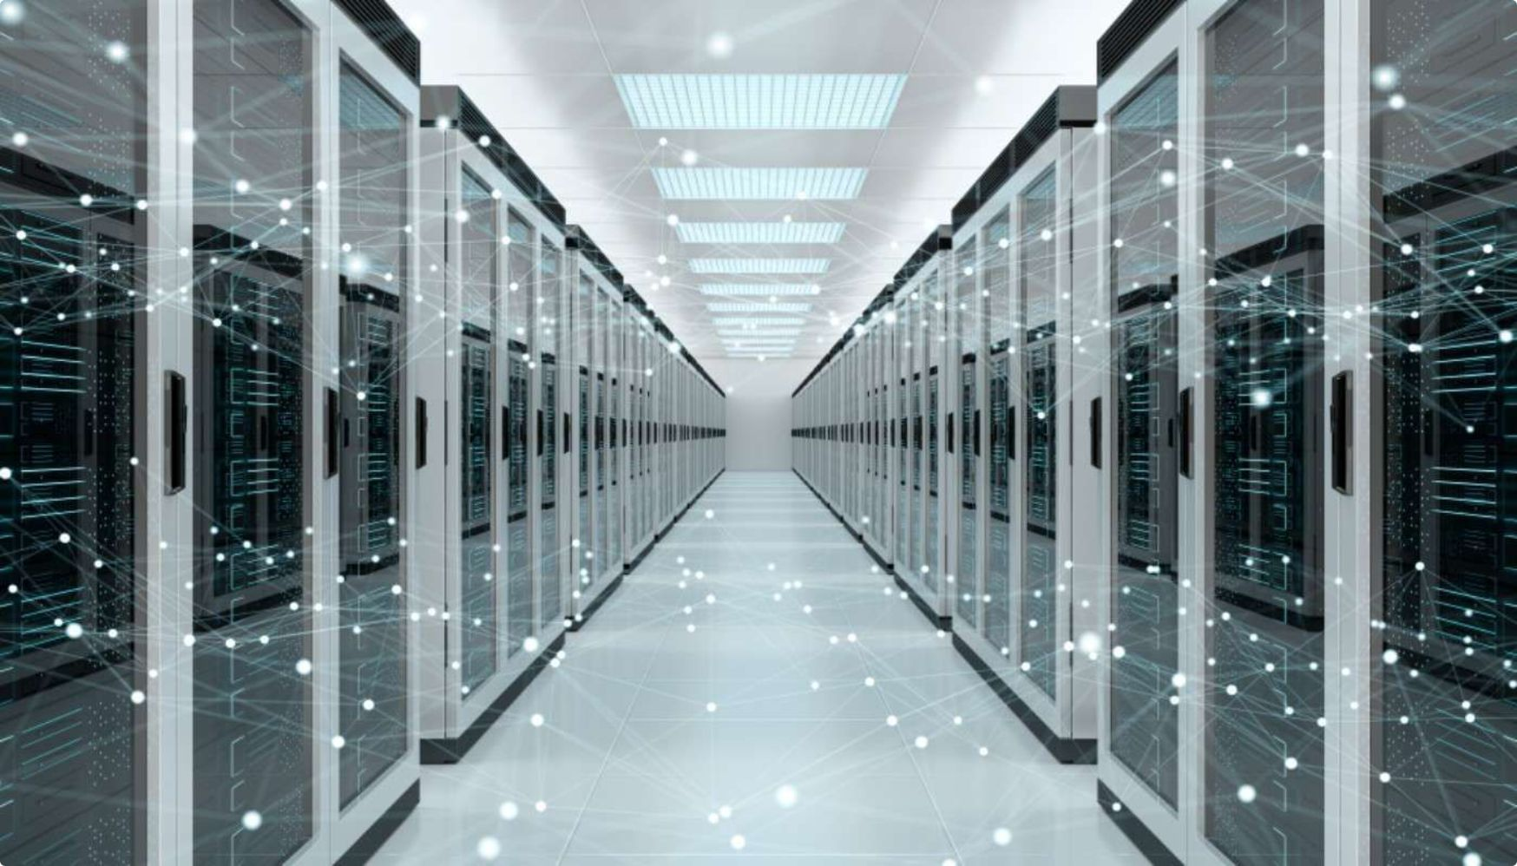
System Architecture
Data Collection Layer
Sensors
Cameras
Satellites
Weather Monitoring Stations
Processing Layer
Cloud Servers
AI Models
Data Analytics Engine
Decision & Alert Layers
Risk Assessment Module
Prediction Module
Mobile Notifications · SMS Alerts · Emergency Control Centers
The integration of these components enables continuous monitoring and timely disaster warnings.

Slide 6




AI Techniques Used
Machine Learning
Deep Learning
Learns from historical disaster data to predict future events.
Analyzes satellite images and video feeds for disaster identification.
Computer Vision
Natural Language Processing
Detects smoke, fire, floods, and damaged infrastructure from images.
Analyzes social media and news reports to identify disaster-related information.
These technologies improve the accuracy and speed of disaster detection.

Slide 7
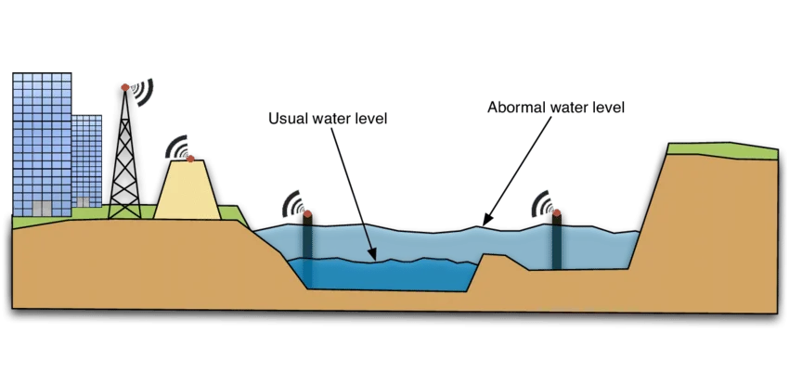

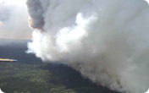
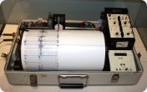
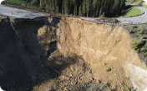
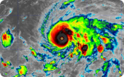
Applications of AI-Based Disaster Detection
Flood Detection
Wildfire Detection
Earthquake Monitoring
Landslide Prediction
Monitors rainfall, river levels, and weather conditions to predict flooding.
Detects smoke and heat patterns using cameras and satellite imagery.
Analyzes seismic activity data to identify earthquake risks.
Uses soil moisture and terrain data to forecast landslides.
Storm and Cyclone Tracking
Predicts cyclone paths and intensity using weather data.
These applications help save lives through early warning systems.

Slide 8






Advantages of AI-Based Disaster Detection
Early Warning
Saves Lives
Timely disaster alerts before events escalate
Reduced loss of human life through proactive action
Rapid Response
24/7 Monitoring
Improved emergency response and coordination
Continuous real-time monitoring without interruption
Accurate Predictions
Better Coordination
Accurate prediction, analysis, and resource allocation
Efficient coordination among rescue teams
AI enables authorities to take preventive actions before disasters become severe.

Slide 9
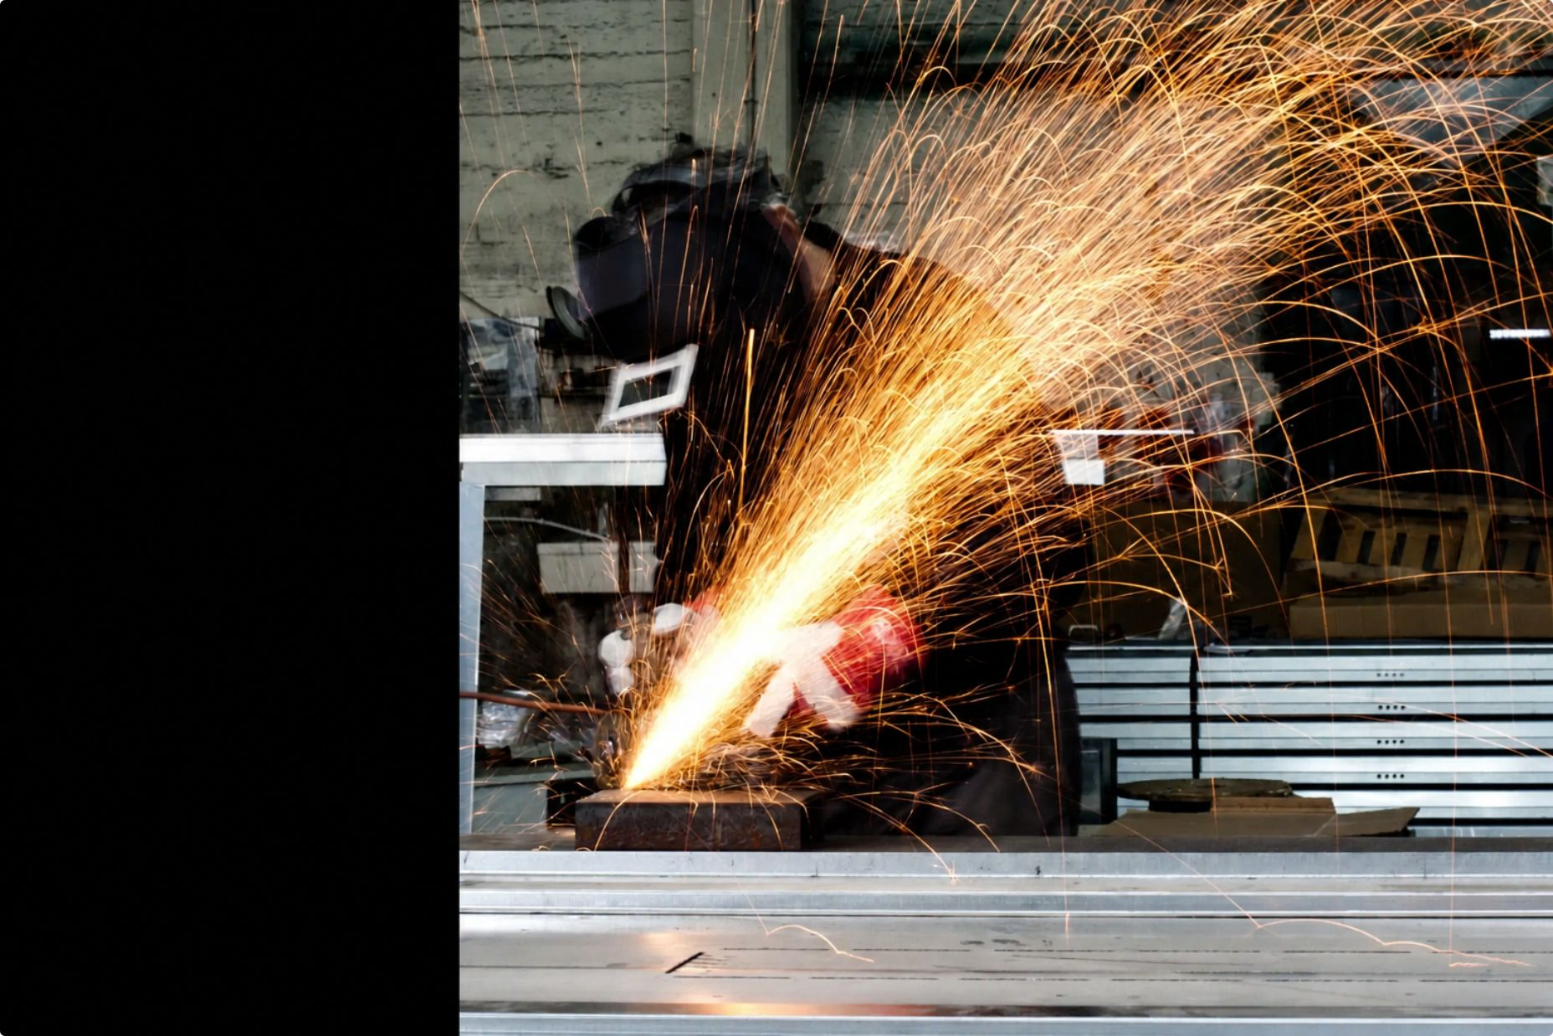
Challenges and Limitations
Despite these challenges, continuous technological advancements are making AI-based disaster systems more reliable and accessible.
High Implementation Cost
Large Dataset Requirements
Significant investment required for infrastructure and deployment
AI models depend on extensive historical data for training
Connectivity & Sensor Issues
False Alarms & Privacy
Dependence on internet connectivity and risk of sensor failures
Risk of false alarms and data privacy and security concerns

Slide 10
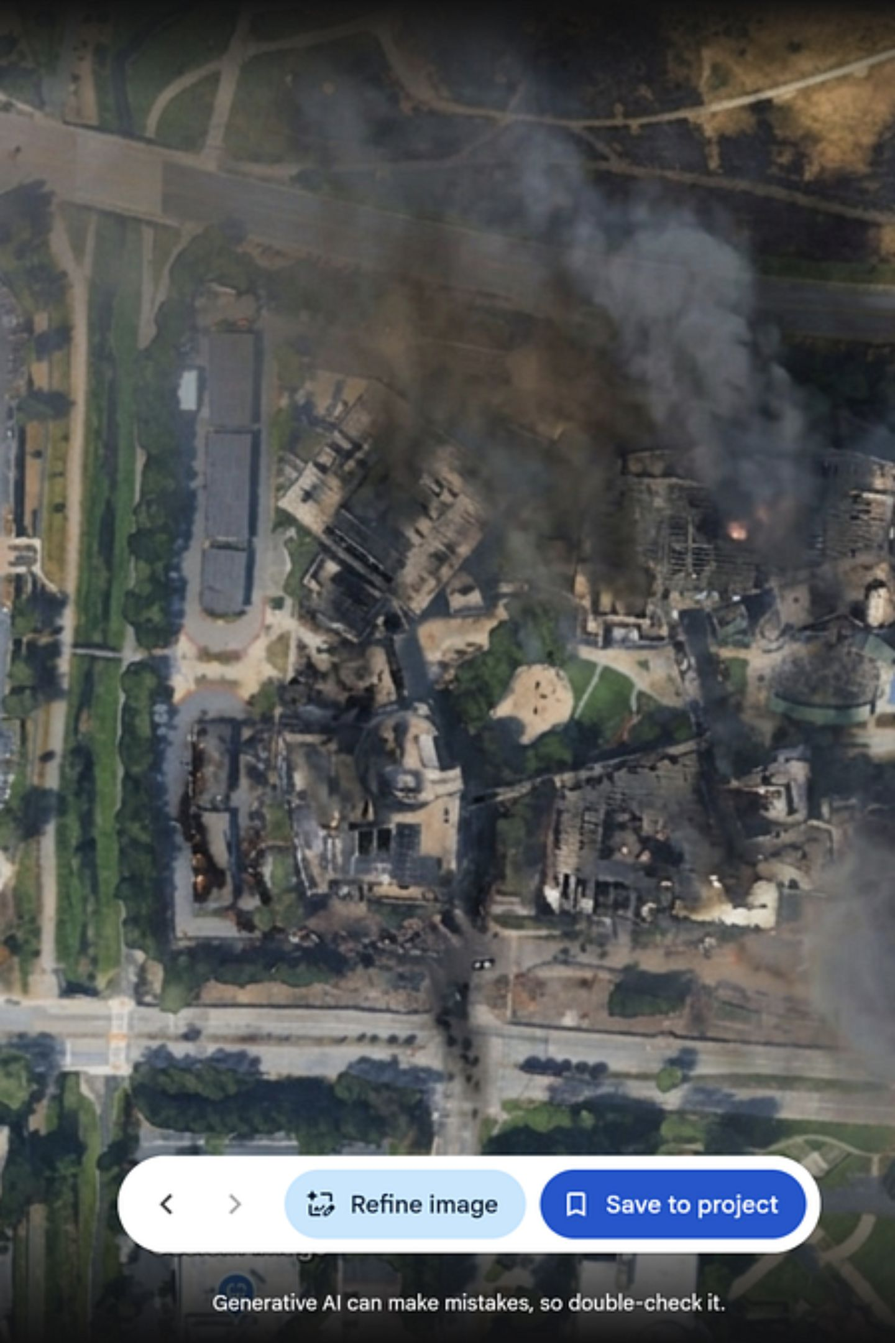
Conclusion
AI-Based Disaster Detection Systems play a crucial role in modern disaster management by providing early warnings, real-time monitoring, and accurate predictions. By combining technologies such as Machine Learning, Deep Learning, Computer Vision, and IoT sensors, these systems help reduce the impact of disasters on society.
Machine Learning
Deep Learning
Computer Vision
IoT Sensors
As AI technology continues to evolve, disaster detection systems will become more intelligent, efficient, and capable of protecting communities worldwide.

Slide 11
